Slide 1
Laws & Agencies Food
Leaving Certificate
Home Economics

Slide 3
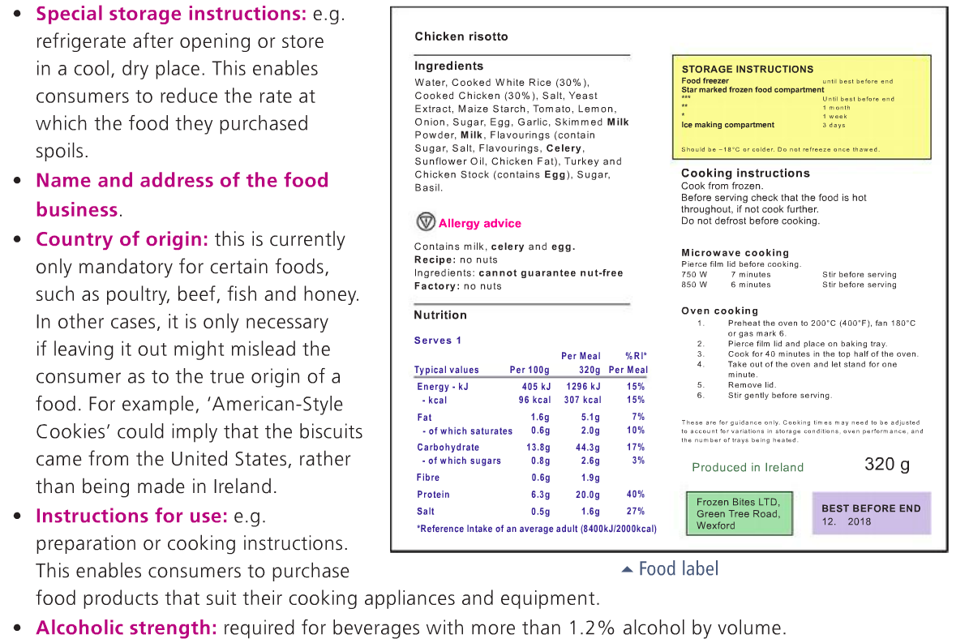

Slide 4
